Slide 1
AWS Price Results
Algorithm_Name | W_Precision | W_Recall | W_F1 | W_AUC | Kappa | Matthews
CDDRL-Tabu10+Params | 0.99 | 0.98 | 0.98 | 1 | 0.98 | 0.98
CDDRL-Ensemble_Methods | 0.98 | 0.98 | 0.98 | 0.99 | 0.96 | 0.96
CDDRL-Ensemble_BNs | 0.99 | 0.99 | 0.99 | 1 | 0.98 | 0.98
KNN-ADWIN | 0.74 | 0.74 | 0.73 | 0.87 | 0.61 | 0.62
AWE | 0.47 | 0.62 | 0.51 | - | 0.42 | 0.5
DWM | 0.47 | 0.6 | 0.5 | - | 0.39 | 0.47
LNSE | 0.98 | 0.98 | 0.98 | 1 | 0.97 | 0.97
SRP | 0.93 | 0.92 | 0.92 | 0.97 | 0.89 | 0.89
SAM-KNN | 0.7 | 0.7 | 0.68 | - | 0.54 | 0.55
VFDR | 0.66 | 0.55 | 0.49 | 0.71 | 0.32 | 0.37
RSLVQ | 0.53 | 0.54 | 0.52 | - | 0.3 | 0.31
OBC | 0.79 | 0.79 | 0.79 | 0.9 | 0.68 | 0.69
ARF | 0.96 | 0.95 | 0.95 | 0.99 | 0.93 | 0.93
NN-UN | 0.88 | 0.85 | 0.84 | 0.95 | 0.78 | 0.79
NYC Subway Traffic Results
Algorithm_Name | W_Precision | W_Recall | W_F1 | W_AUC | Kappa | Matthews
CDDRL-Tabu10+Params | 0.83 | 0.82 | 0.82 | 0.94 | 0.71 | 0.71
CDDRL-Ensemble_Methods | 0.85 | 0.84 | 0.84 | 0.95 | 0.75 | 0.76
CDDRL-Ensemble_BNs | 0.82 | 0.79 | 0.8 | 0.92 | 0.68 | 0.68
KNN-ADWIN | 0.81 | 0.81 | 0.8 | 0.93 | 0.69 | 0.69
AWE | 0.6 | 0.64 | 0.58 | - | 0.42 | 0.45
DWM | 0.57 | 0.6 | 0.55 | - | 0.38 | 0.41
LNSE | 0.81 | 0.81 | 0.81 | 0.94 | 0.7 | 0.7
SRP | 0.75 | 0.75 | 0.74 | 0.89 | 0.6 | 0.61
SAM-KNN | 0.82 | 0.82 | 0.81 | - | 0.71 | 0.71
VFDR | 0.6 | 0.61 | 0.56 | 0.78 | 0.38 | 0.4
RSLVQ | 0.55 | 0.52 | 0.5 | - | 0.26 | 0.28
OBC | 0.8 | 0.79 | 0.79 | 0.92 | 0.67 | 0.67
ARF | 0.85 | 0.84 | 0.84 | 0.95 | 0.75 | 0.75
NN-UN | 0.78 | 0.74 | 0.72 | 0.9 | 0.58 | 0.59

Slide 2
Electricity Results
Algorithm_Name | FA | F1_pos | F1_neg | F1_Avg | Geometric_mean | Balanced_Accuracy | Y_score | AUC
CDDRL-Tabu10+Params | 0.19 | 0.59 | 0.75 | 0.67 | 0.64 | 0.69 | 0.72 | 0.77
CDDRL-Ensemble_Methods | 0.14 | 0.56 | 0.78 | 0.67 | 0.62 | 0.69 | 0.72 | 0.79
CDDRL-Ensemble_BNs | 0.14 | 0.69 | 0.82 | 0.75 | 0.73 | 0.76 | 0.79 | 0.86
KNN-ADWIN | 0.19 | 0.65 | 0.78 | 0.72 | 0.7 | 0.73 | 0.74 | 0.8
AWE | 0.16 | 0.63 | 0.79 | 0.71 | 0.68 | 0.73 | 0.75 | -
DWM | 0.12 | 0.6 | 0.8 | 0.7 | 0.66 | 0.72 | 0.75 | -
LNSE | 0.21 | 0.68 | 0.78 | 0.73 | 0.72 | 0.74 | 0.75 | 0.85
SRP | 0.17 | 0.67 | 0.8 | 0.73 | 0.72 | 0.74 | 0.76 | 0.83
SAM-KNN | 0.15 | 0.6 | 0.79 | 0.69 | 0.66 | 0.71 | 0.73 | -
VFDR | 0.19 | 0.62 | 0.76 | 0.69 | 0.66 | 0.71 | 0.73 | 0.81
RSLVQ | 0.42 | 0.58 | 0.61 | 0.6 | 0.58 | 0.63 | 0.64 | -
OBC | 0.21 | 0.64 | 0.77 | 0.71 | 0.7 | 0.72 | 0.72 | 0.8
ARF | 0.17 | 0.68 | 0.8 | 0.74 | 0.72 | 0.75 | 0.77 | 0.85
NN-UN | 0.11 | 0.58 | 0.8 | 0.69 | 0.65 | 0.71 | 0.74 | 0.81
Instagram Followers Results
Algorithm_Name | FA | F1_pos | F1_neg | F1_Avg | Geometric_mean | Balanced_Accuracy | Y_score | AUC
CDDRL-Tabu10+Params | 0.27 | 0.69 | 0.7 | 0.7 | 0.68 | 0.71 | 0.71 | 0.75
CDDRL-Ensemble_Methods | 0.29 | 0.72 | 0.71 | 0.72 | 0.7 | 0.73 | 0.73 | 0.76
CDDRL-Ensemble_BNs | 0.26 | 0.65 | 0.69 | 0.67 | 0.64 | 0.69 | 0.69 | 0.73
KNN-ADWIN | 0.33 | 0.69 | 0.67 | 0.68 | 0.68 | 0.69 | 0.69 | 0.72
AWE | 0.2 | 0.7 | 0.75 | 0.72 | 0.68 | 0.75 | 0.75 | -
DWM | 0.27 | 0.59 | 0.68 | 0.63 | 0.59 | 0.66 | 0.65 | -
LNSE | 0.25 | 0.72 | 0.73 | 0.72 | 0.7 | 0.74 | 0.74 | 0.74
SRP | 0.26 | 0.72 | 0.72 | 0.72 | 0.7 | 0.73 | 0.74 | 0.77
SAM-KNN | 0.32 | 0.68 | 0.68 | 0.68 | 0.67 | 0.69 | 0.69 | -
VFDR | 0.22 | 0.67 | 0.73 | 0.7 | 0.67 | 0.72 | 0.73 | 0.75
RSLVQ | 0.45 | 0.57 | 0.54 | 0.55 | 0.52 | 0.58 | 0.59 | -
OBC | 0.33 | 0.67 | 0.67 | 0.67 | 0.67 | 0.68 | 0.68 | 0.71
ARF | 0.27 | 0.73 | 0.72 | 0.72 | 0.7 | 0.73 | 0.74 | 0.76
NN-UN | 0.41 | 0.62 | 0.58 | 0.6 | 0.58 | 0.62 | 0.63 | 0.65

Slide 3
Usenet Results
Algorithm_Name | FA | F1_pos | F1_neg | F1_Avg | Geometric_mean | Balanced_Accuracy | Y_score | AUC
CDDRL-Tabu10+Params | 0.37 | 0.52 | 0.57 | 0.54 | 0.46 | 0.59 | 0.60 | 0.61
CDDRL-Ensemble_Methods | 0.39 | 0.57 | 0.55 | 0.56 | 0.52 | 0.60 | 0.61 | 0.63
CDDRL-Ensemble_BNs | 0.29 | 0.45 | 0.57 | 0.51 | 0.46 | 0.57 | 0.58 | 0.57
KNN-ADWIN | 0.48 | 0.49 | 0.49 | 0.49 | 0.49 | 0.54 | 0.54 | 0.55
AWE | 0.27 | 0.55 | 0.66 | 0.60 | 0.57 | 0.62 | 0.63 | -
DWM | 0.47 | 0.58 | 0.55 | 0.56 | 0.55 | 0.59 | 0.59 | -
LNSE | 0.36 | 0.43 | 0.55 | 0.49 | 0.46 | 0.54 | 0.53 | 0.54
SRP | 0.49 | 0.58 | 0.48 | 0.53 | 0.46 | 0.58 | 0.59 | 0.61
SAM-KNN | 0.42 | 0.49 | 0.53 | 0.51 | 0.41 | 0.57 | 0.59 | -
VFDR | 0.59 | 0.67 | 0.50 | 0.59 | 0.58 | 0.63 | 0.64 | 0.66
RSLVQ | 0.45 | 0.41 | 0.40 | 0.40 | 0.24 | 0.54 | 0.51 | -
OBC | 0.50 | 0.53 | 0.51 | 0.52 | 0.54 | 0.55 | 0.55 | 0.55
ARF | 0.49 | 0.54 | 0.47 | 0.50 | 0.40 | 0.56 | 0.58 | 0.55
NN-UN | 0.22 | 0.46 | 0.65 | 0.55 | 0.53 | 0.60 | 0.59 | 0.61
Fertilizer Stress Results
Algorithm_Name | FA | F1_pos | F1_neg | F1_Avg | Geometric_mean | Balanced_Accuracy | Y_score | AUC
CDDRL-Tabu10+Params | 0.06 | 0.88 | 0.95 | 0.92 | 0.92 | 0.92 | 0.92 | 0.95
CDDRL-Ensemble_Methods | 0 | 0.88 | 0.97 | 0.93 | 0.9 | 0.91 | 0.94 | 0.95
CDDRL-Ensemble_BNs | 0 | 0.84 | 0.96 | 0.9 | 0.86 | 0.88 | 0.92 | 0.95
KNN-ADWIN | 0.02 | 0.87 | 0.96 | 0.92 | 0.89 | 0.9 | 0.92 | 0.96
AWE | 0.02 | 0.88 | 0.97 | 0.93 | 0.91 | 0.92 | 0.93 | -
DWM | 0.01 | 0.77 | 0.95 | 0.86 | 0.79 | 0.85 | 0.88 | -
LNSE | 0.02 | 0.9 | 0.97 | 0.93 | 0.92 | 0.92 | 0.94 | 0.96
SRP | 0 | 0.86 | 0.97 | 0.91 | 0.88 | 0.9 | 0.93 | 0.97
SAM-KNN | 0 | 0.58 | 0.93 | 0.76 | 0.59 | 0.77 | 0.78 | -
VFDR | 0.02 | 0.9 | 0.97 | 0.93 | 0.91 | 0.92 | 0.93 | 0.97
RSLVQ | 0 | 0.76 | 0.95 | 0.86 | 0.79 | 0.85 | 0.9 | -
OBC | 0 | 0.83 | 0.97 | 0.9 | 0.85 | 0.9 | 0.91 | 0.98
ARF | 0 | 0.82 | 0.96 | 0.89 | 0.84 | 0.88 | 0.92 | 0.97

Slide 4
Old Water Stress Results
Algorithm_Name | W_Precision | W_Recall | W_F1 | W_AUC | Kappa | Matthews | Multiclass Accuracy
CDDRL-Tabu10+Params | 0.83 | 0.85 | 0.81 | 0.96 | 0.8 | 0.82 | 0.85
CDDRL-Ensemble_Methods | 0.82 | 0.84 | 0.8 | 0.89 | 0.79 | 0.81 | 0.84
CDDRL-Ensemble_BNs | 0.79 | 0.84 | 0.8 | 0.9 | 0.79 | 0.82 | 0.84
KNN-ADWIN | 0.81 | 0.81 | 0.79 | 0.92 | 0.75 | 0.76 | 0.81
AWE | 0.68 | 0.74 | 0.69 | - | 0.66 | 0.68 | 0.74
DWM | 0.82 | 0.81 | 0.77 | - | 0.74 | 0.77 | 0.81
LNSE | 0.81 | 0.87 | 0.83 | 0.96 | 0.82 | 0.84 | 0.87
SRP | 0.82 | 0.88 | 0.84 | 0.93 | 0.84 | 0.86 | 0.88
SAM-KNN | 0.76 | 0.77 | 0.74 | - | 0.69 | 0.71 | 0.77
VFDR | 0.43 | 0.54 | 0.45 | 0.72 | 0.39 | 0.43 | 0.54
RSLVQ | 0.59 | 0.57 | 0.5 | - | 0.43 | 0.46 | 0.57
OBC | 0.81 | 0.8 | 0.78 | 0.92 | 0.74 | 0.75 | 0.8
ARF | 0.91 | 0.9 | 0.87 | 0.96 | 0.86 | 0.88 | 0.9
New Water Stress Results
Algorithm_Name | FA | F1_pos | F1_neg | F1_Avg | Geometric_mean | Balanced_Accuracy | Y_score | AUC
CDDRL-Tabu10+Params | 0.17 | 0.49 | 0.84 | 0.66 | 0.62 | 0.69 | 0.67 | 0.74
CDDRL-Ensemble_Methods | 0.17 | 0.48 | 0.83 | 0.65 | 0.61 | 0.68 | 0.67 | 0.75
CDDRL-Ensemble_BNs | 0.17 | 0.5 | 0.84 | 0.67 | 0.63 | 0.69 | 0.68 | 0.76
KNN-ADWIN | 0.12 | 0.45 | 0.85 | 0.65 | 0.57 | 0.65 | 0.66 | 0.7
AWE | 0.11 | 0.38 | 0.84 | 0.61 | 0.47 | 0.63 | 0.64 | -
DWM | 0.23 | 0.49 | 0.79 | 0.64 | 0.61 | 0.66 | 0.66 | -
LNSE | 0.19 | 0.43 | 0.81 | 0.62 | 0.57 | 0.63 | 0.63 | 0.72
SRP | 0.19 | 0.49 | 0.79 | 0.64 | 0.57 | 0.66 | 0.68 | 0.76
SAM-KNN | 0.06 | 0.4 | 0.86 | 0.63 | 0.48 | 0.64 | 0.67 | -
VFDR | 0.2 | 0.47 | 0.81 | 0.64 | 0.58 | 0.67 | 0.66 | 0.71
RSLVQ | 0.46 | 0.37 | 0.57 | 0.47 | 0.39 | 0.58 | 0.56 | -
OBC | 0.39 | 0.48 | 0.66 | 0.57 | 0.56 | 0.64 | 0.62 | 0.71
ARF | 0.31 | 0.47 | 0.69 | 0.58 | 0.53 | 0.64 | 0.63 | 0.72

Slide 5
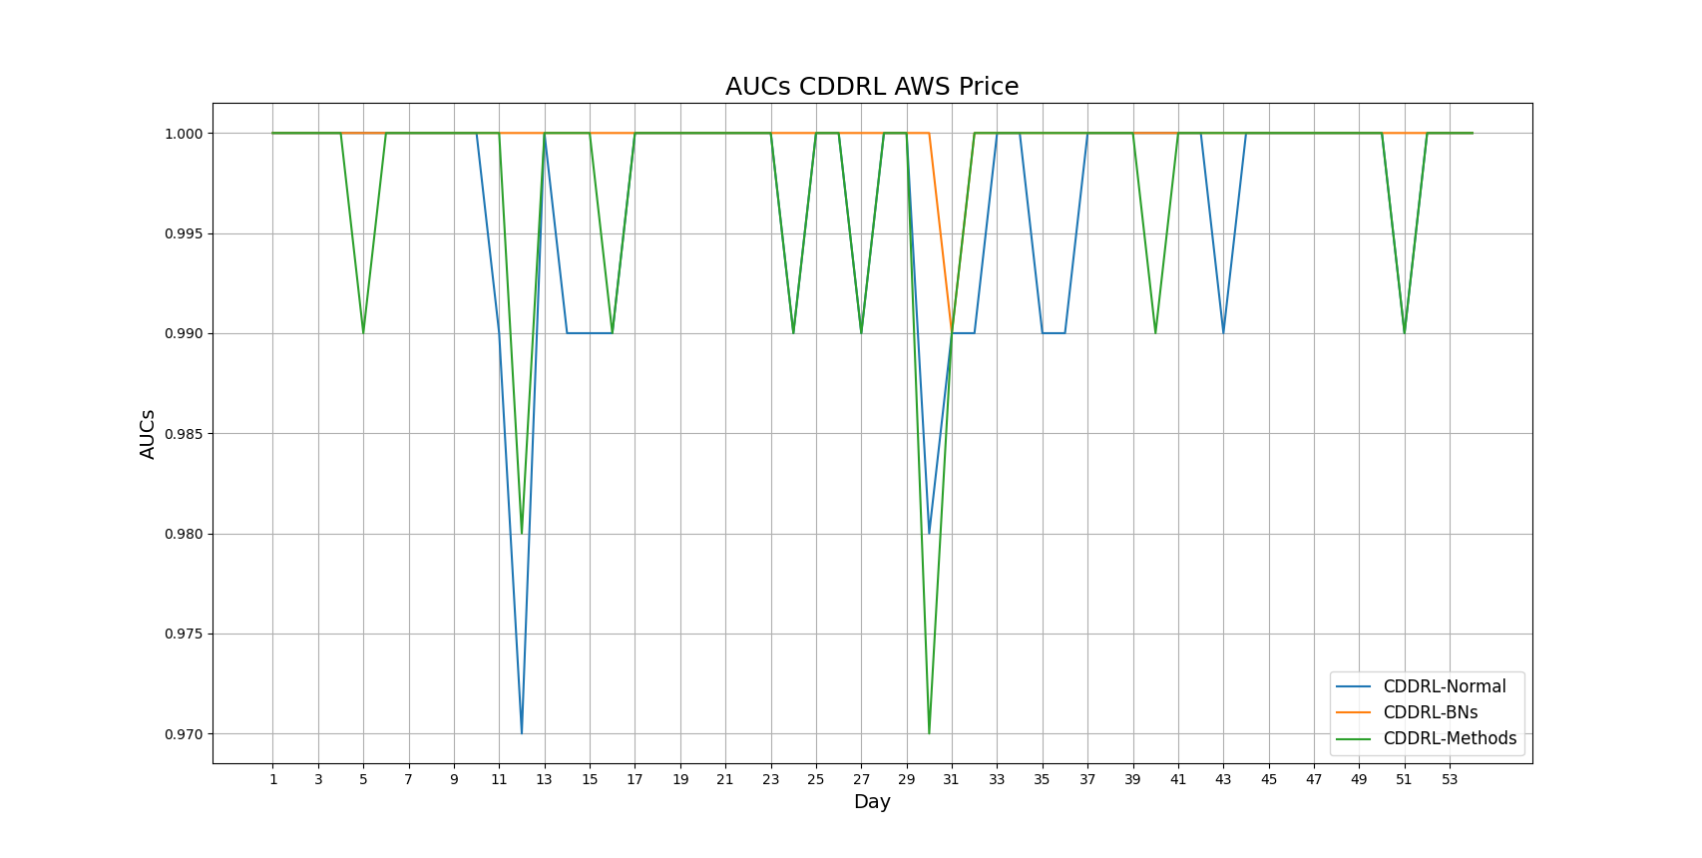
AWS Price Graph

Slide 6
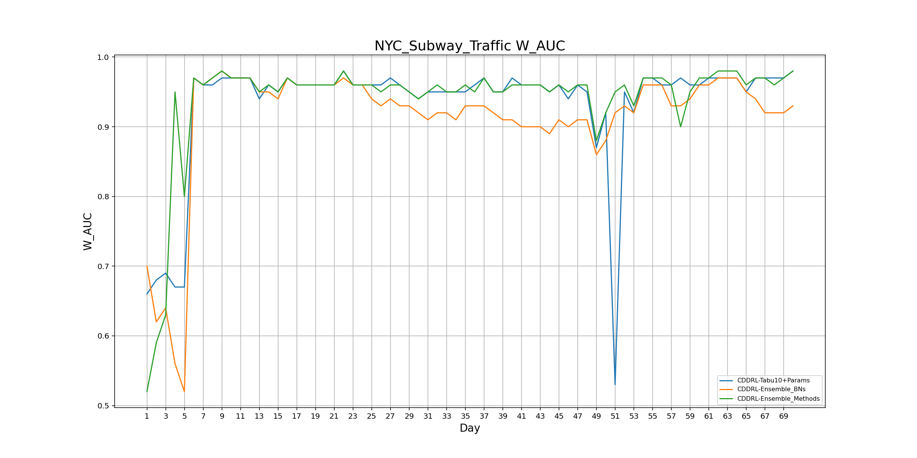
NYC Subway Traffic Graph

Slide 7
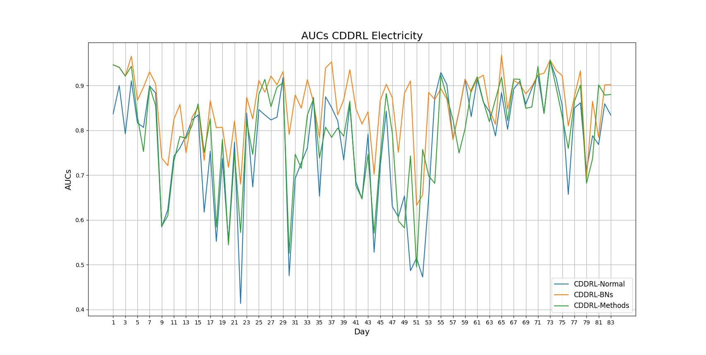
Electricity Graph

Slide 8
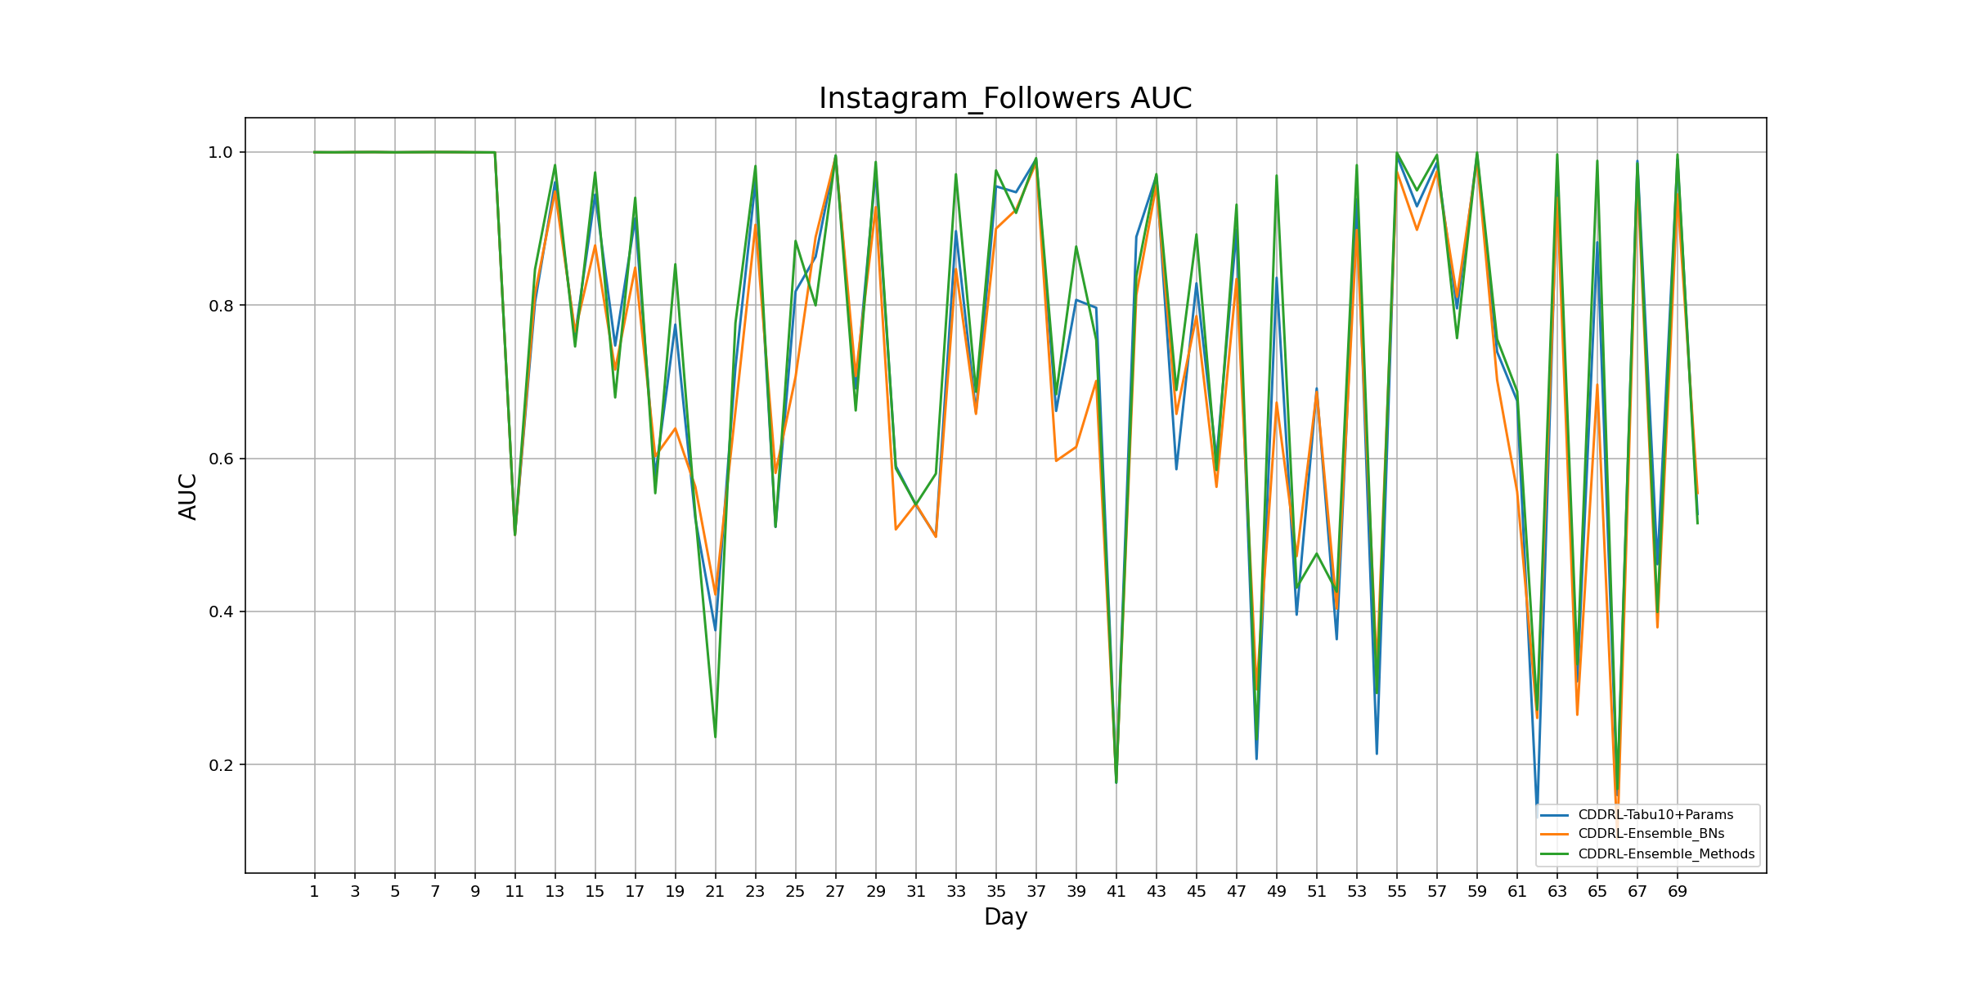
Instagram Followers Graph

Slide 9
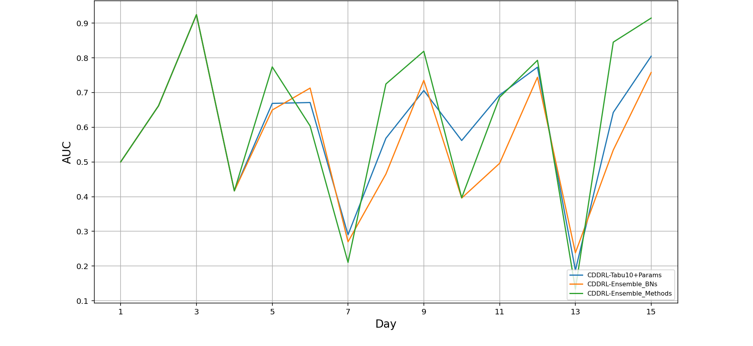
Usenet Graph

Slide 10
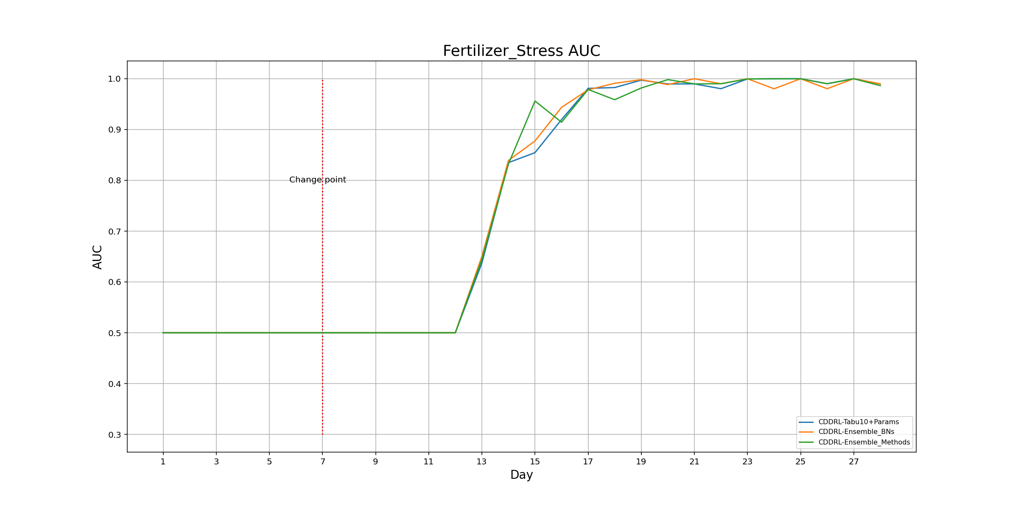
Fertilizer Stress Graph

Slide 11
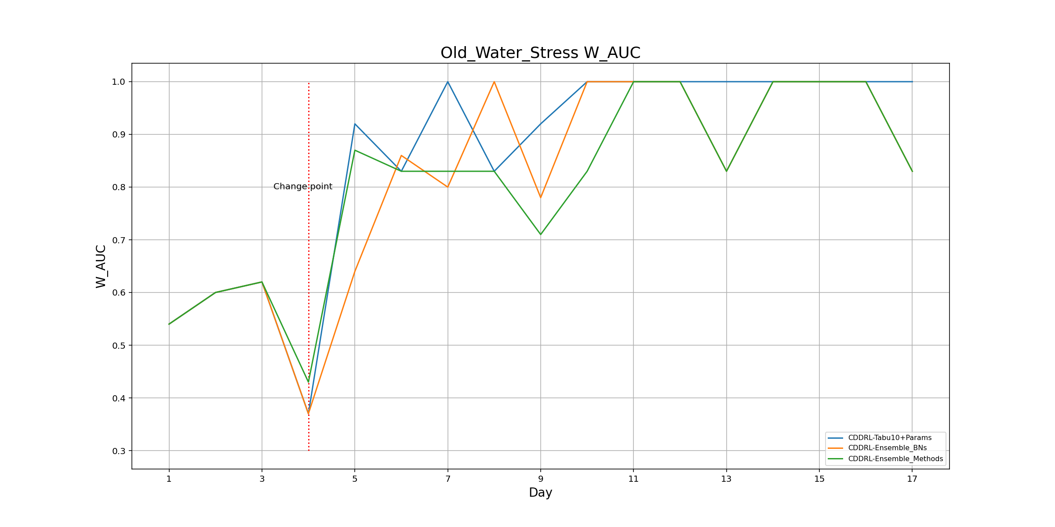
Old Water Stress Graph

Slide 12
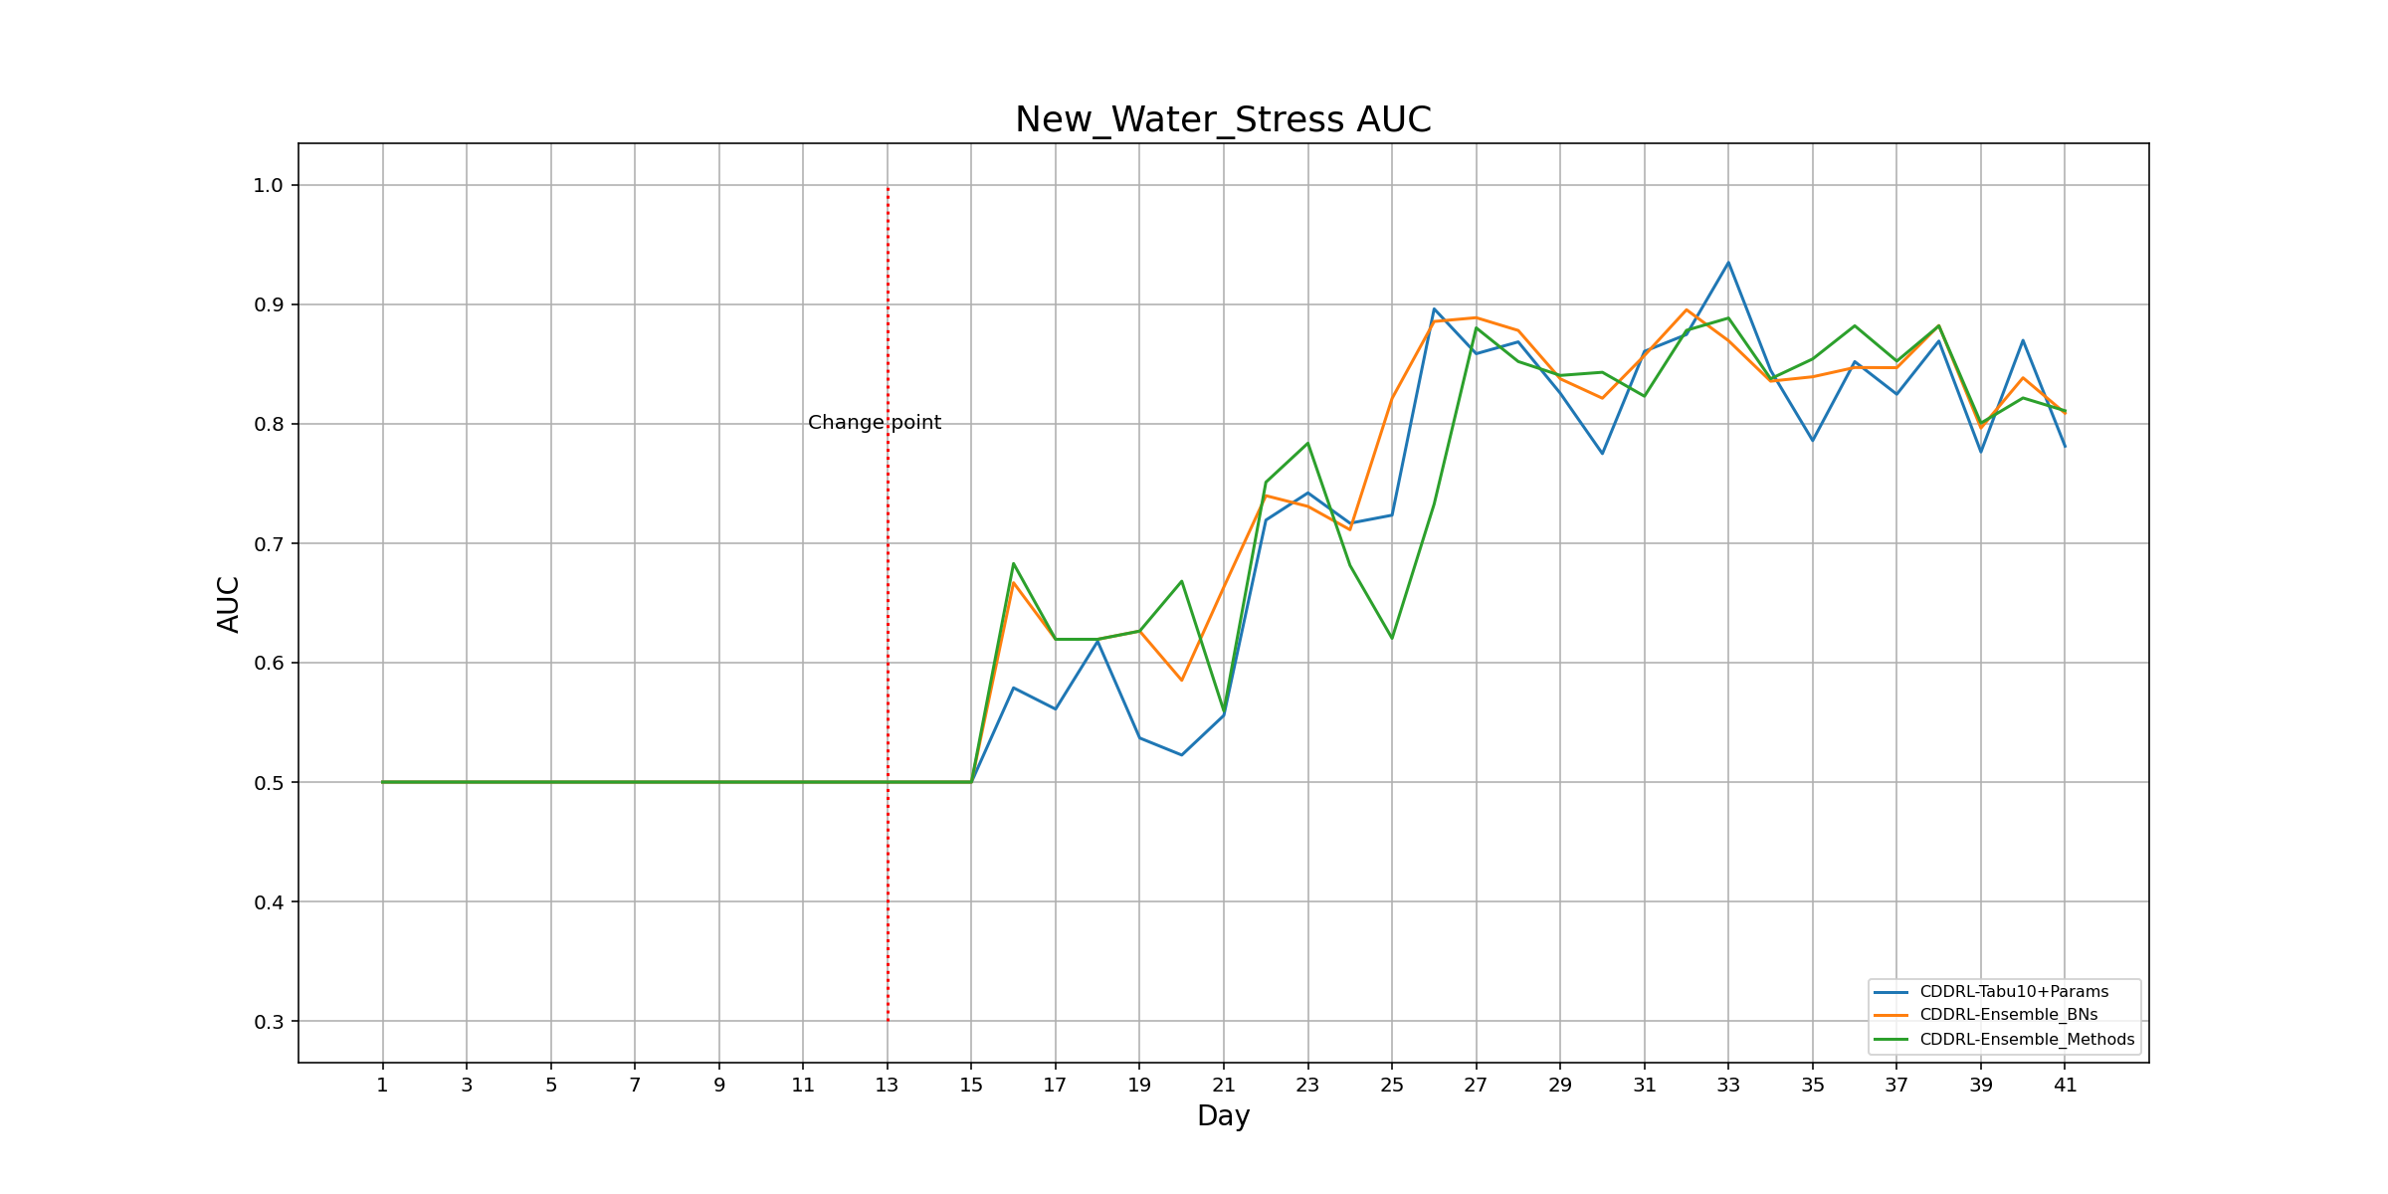
New Water Stress Graph

Slide 13
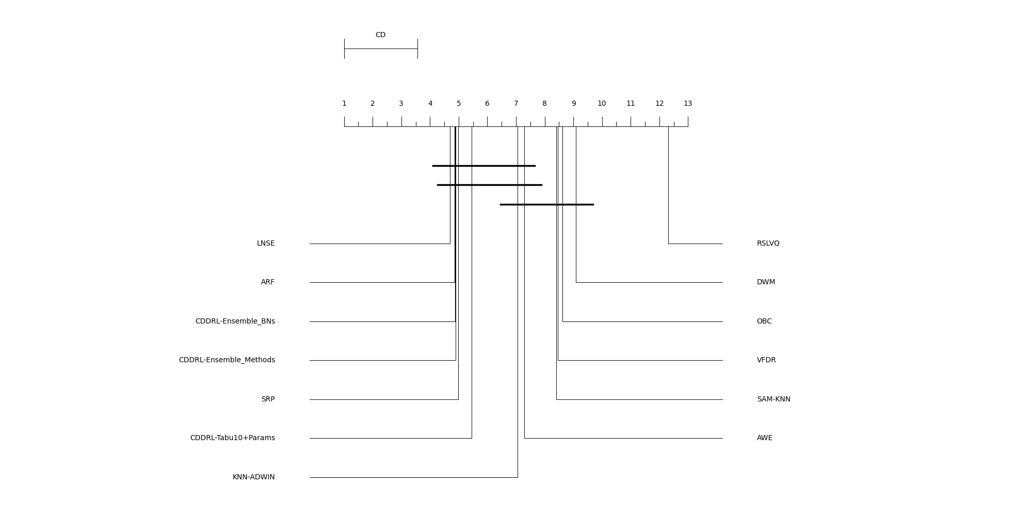
Friedman Test – Without Usenet and NN-UN
Algorithm | Rank
LNSE | 4.693
ARF | 4.864
CDDRL-Ensemble_BNs | 4.875
CDDRL-Ensemble_Methods | 4.886
SRP | 4.989
CDDRL-Tabu10+Params | 5.455
KNN-ADWIN | 7.057
AWE | 7.284
SAM-KNN | 8.409
VFDR | 8.466
OBC | 8.625
DWM | 9.091
RSLVQ | 12.307
CD | 2.555

Slide 14
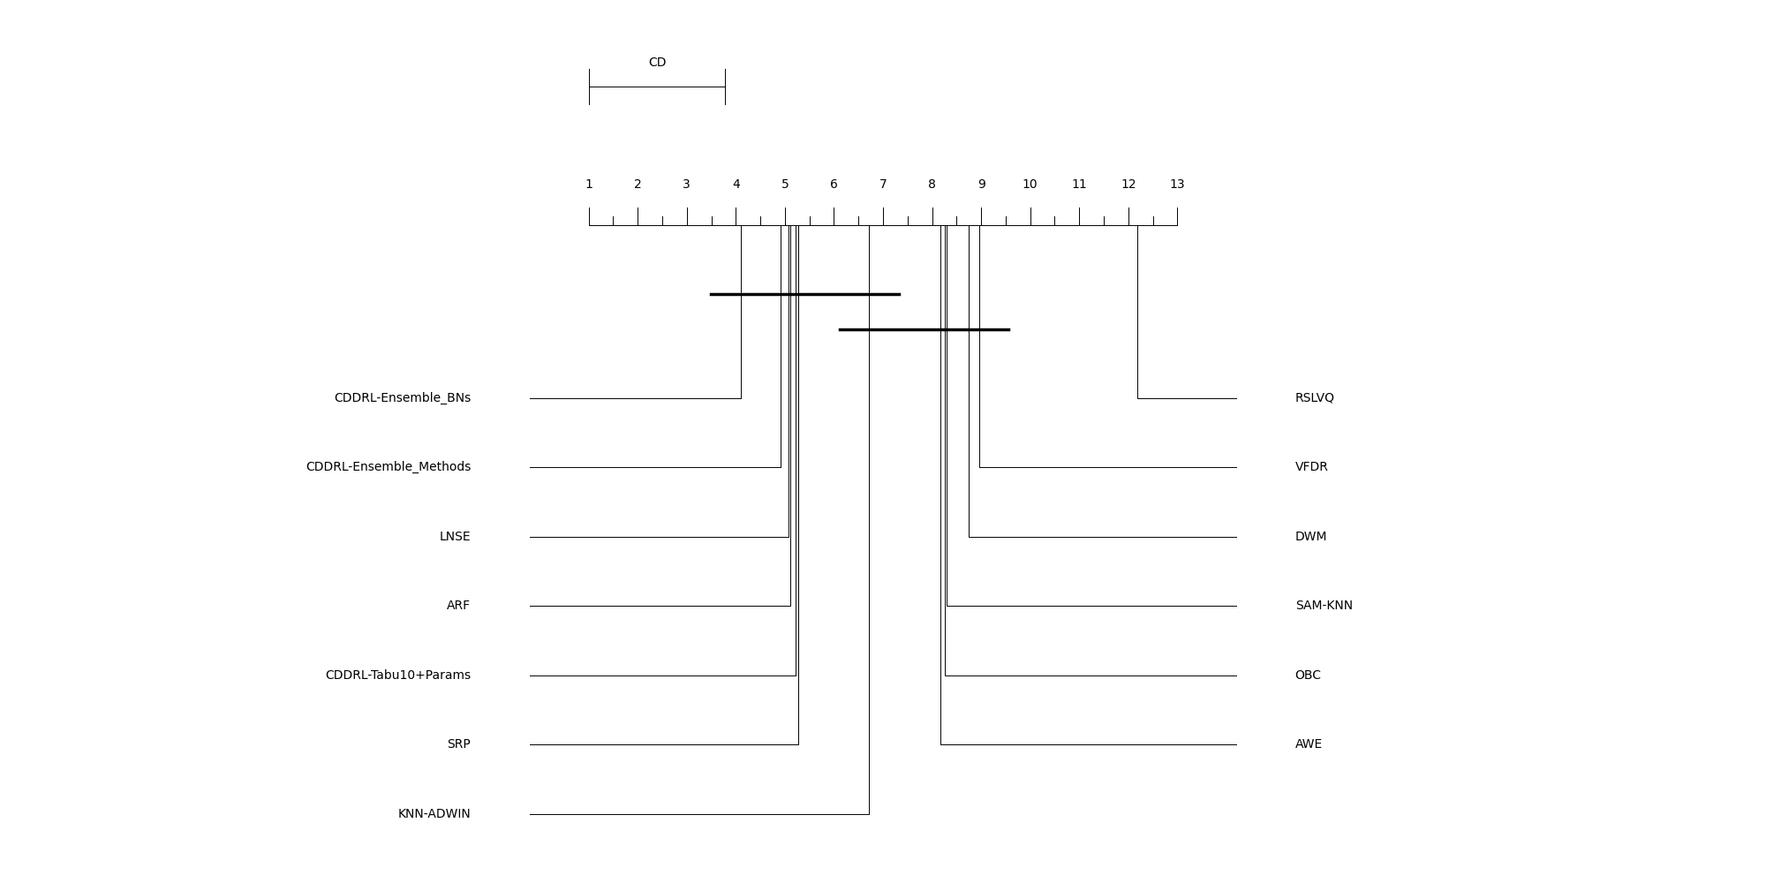
Friedman Test – Without Usenet, Instagram and NN-UN
Algorithm | Rank
CDDRL-Ensemble_BNs | 4.095
CDDRL-Ensemble_Methods | 4.919
LNSE | 5.068
ARF | 5.108
CDDRL-Tabu10+Params | 5.216
SRP | 5.270
KNN-ADWIN | 6.716
AWE | 8.176
OBC | 8.257
SAM-KNN | 8.297
DWM | 8.743
VFDR | 8.959
RSLVQ | 12.176
CD | 2.786

Slide 15
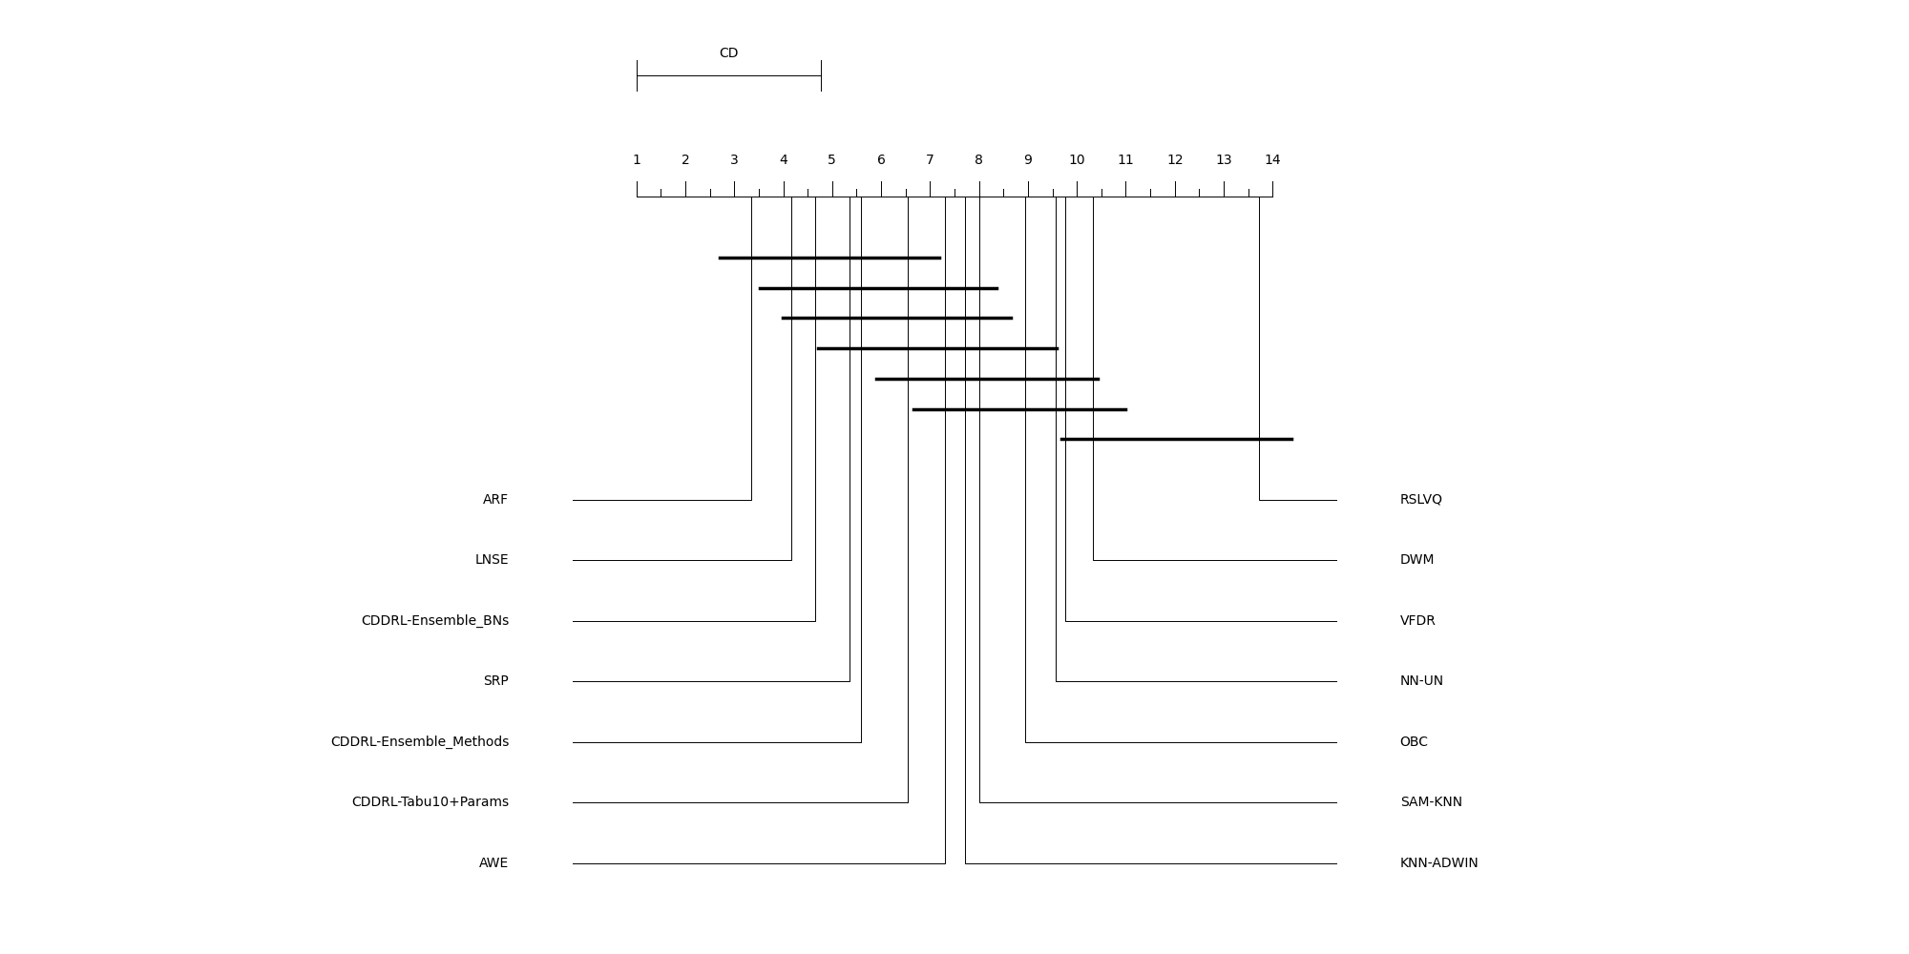
Friedman Test – All Algos, Without Usenet and Stress
Algorithm | Rank
ARF | 3.354
LNSE | 4.167
CDDRL-Ensemble_BNs | 4.646
SRP | 5.354
CDDRL-Ensemble_Methods | 5.583
CDDRL-Tabu10+Params | 6.542
AWE | 7.313
KNN-ADWIN | 7.708
SAM-KNN | 8.000
OBC | 8.938
NN-UN | 9.563
VFDR | 9.771
DWM | 10.333
RSLVQ | 13.729
CD | 3.767

Slide 16
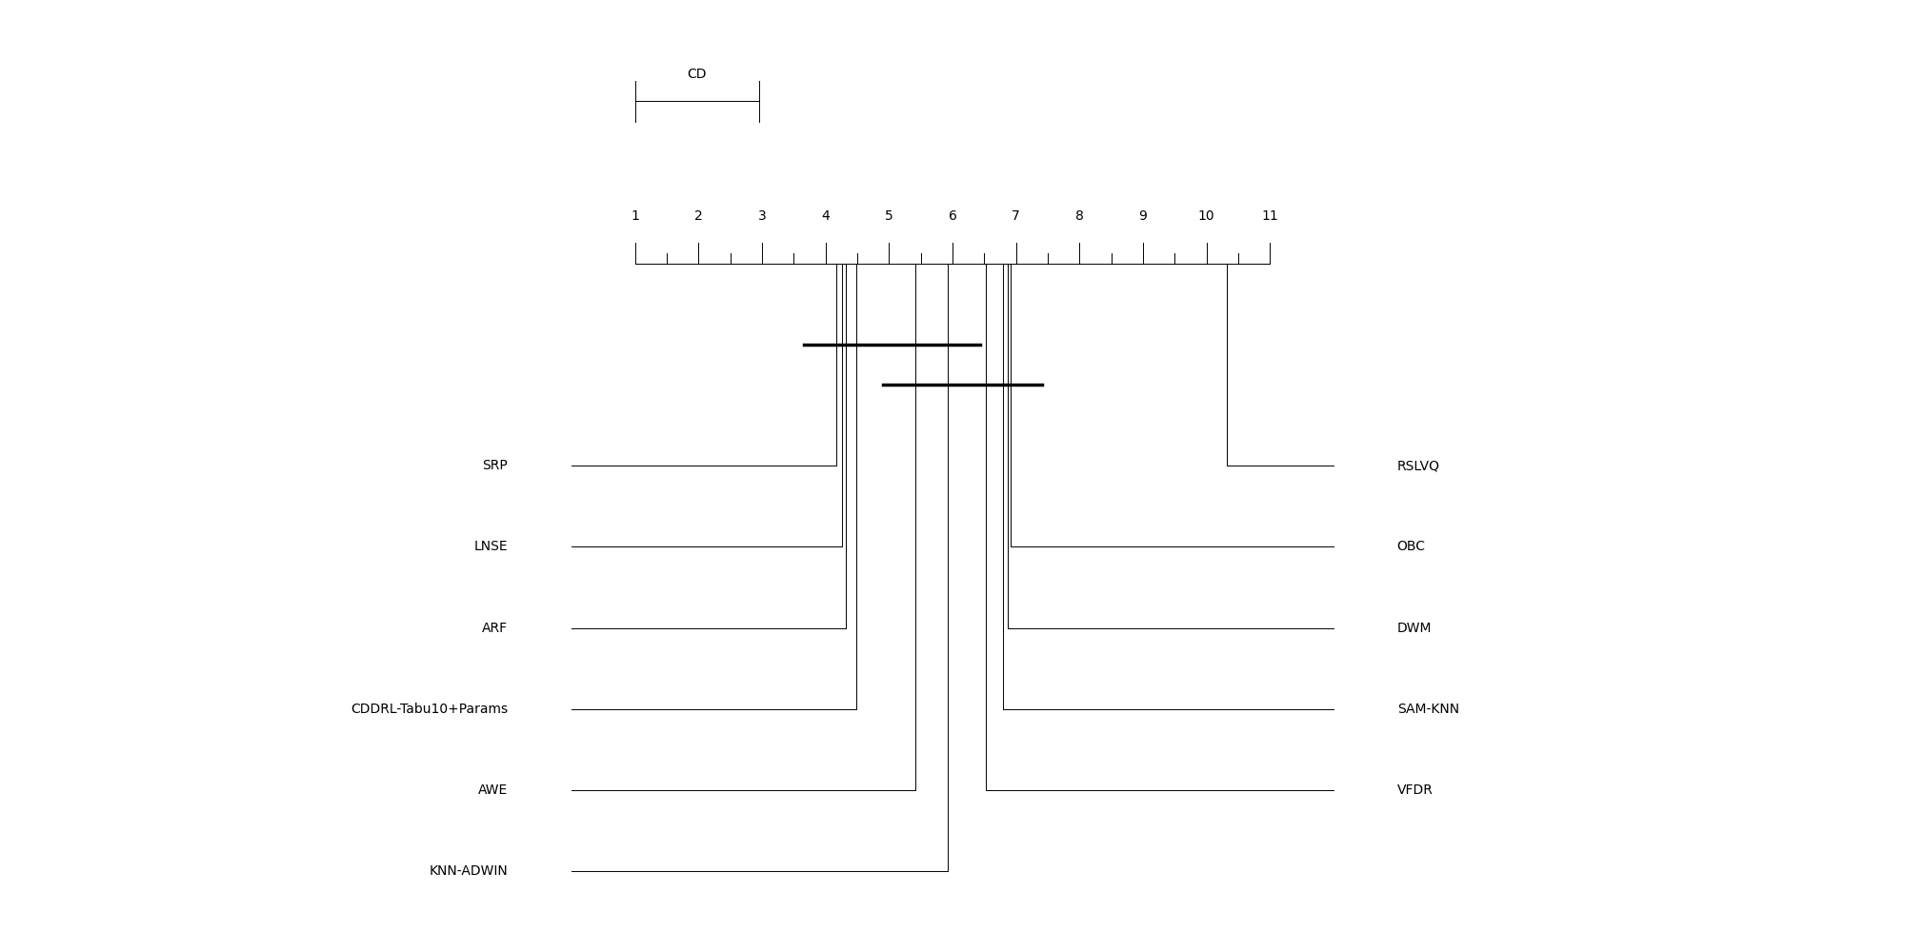
Friedman Test – Without Ensembles and NN-UN
Algorithm | Rank
SRP | 4.167
LNSE | 4.255
ARF | 4.324
CDDRL-Tabu10+Params | 4.480
AWE | 5.412
KNN-ADWIN | 5.931
VFDR | 6.529
SAM-KNN | 6.794
DWM | 6.873
OBC | 6.912
RSLVQ | 10.324
CD | 1.956

Slide 17
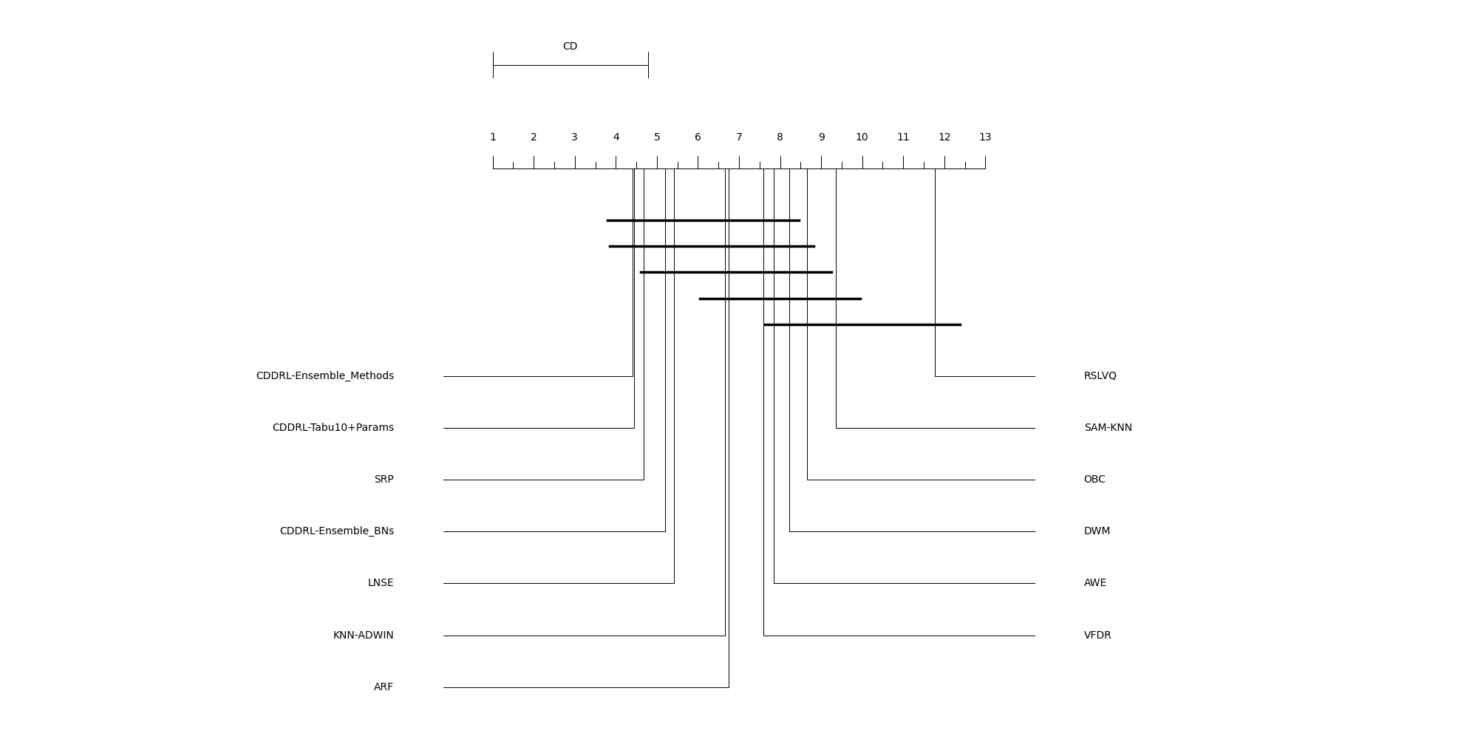
Friedman Test – Stress Only, No NN-UN
Algorithm | Rank
CDDRL-Ensemble_Methods | 4.400
CDDRL-Tabu10+Params | 4.450
SRP | 4.675
CDDRL-Ensemble_BNs | 5.200
LNSE | 5.425
KNN-ADWIN | 6.650
ARF | 6.750
VFDR | 7.600
AWE | 7.850
DWM | 8.225
OBC | 8.650
SAM-KNN | 9.350
RSLVQ | 11.775
CD | 3.789

Slide 18
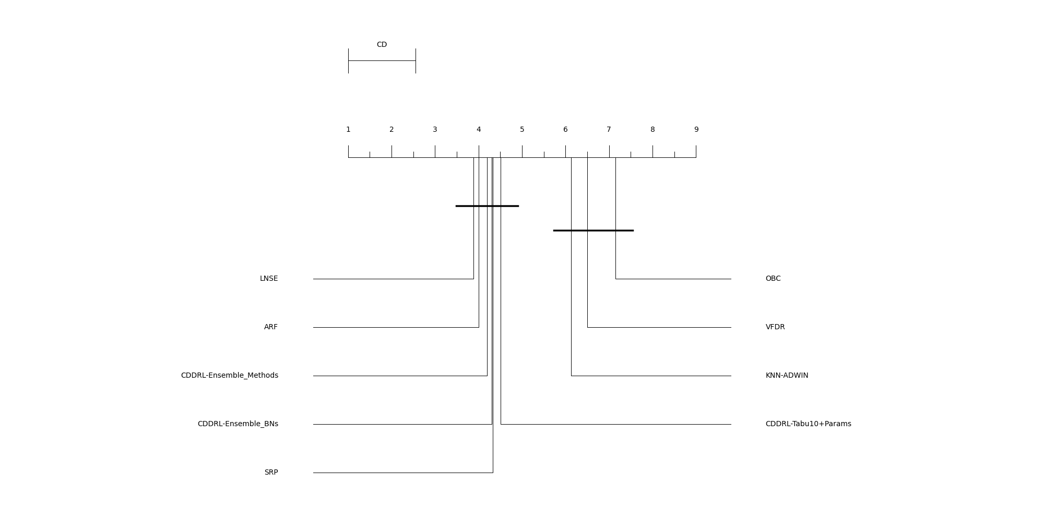
Friedman Test – Without no AUC Algos, No Usenet
Algorithm | Rank
LNSE | 3.882
ARF | 4.010
CDDRL-Ensemble_Methods | 4.196
CDDRL-Ensemble_BNs | 4.304
SRP | 4.324
CDDRL-Tabu10+Params | 4.510
KNN-ADWIN | 6.127
VFDR | 6.500
OBC | 7.147
CD | 1.548

Slide 19
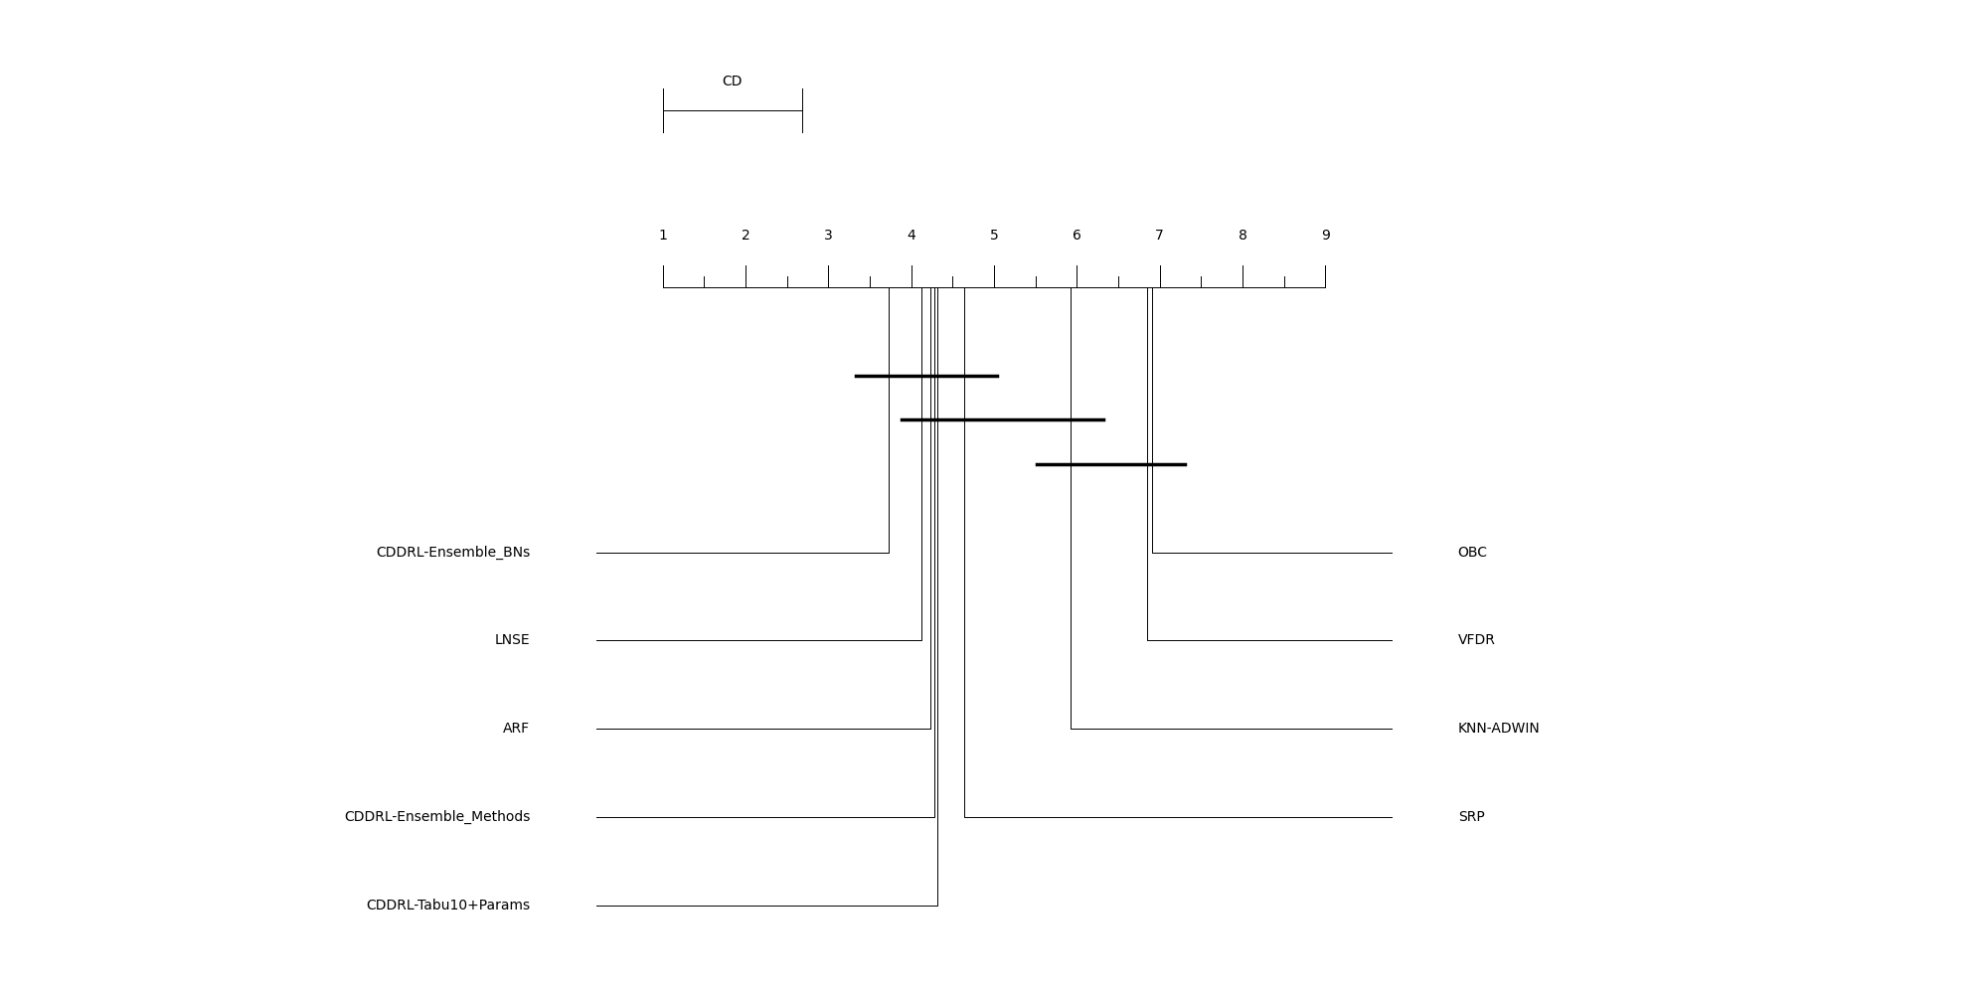
Friedman Test – Without no AUC Algos, No Usenet and Instagram
Algorithm | Rank
CDDRL-Ensemble_BNs | 3.733
LNSE | 4.128
ARF | 4.233
CDDRL-Ensemble_Methods | 4.279
CDDRL-Tabu10+Params | 4.314
SRP | 4.640
KNN-ADWIN | 5.919
VFDR | 6.849
OBC | 6.907
CD | 1.686

Slide 20
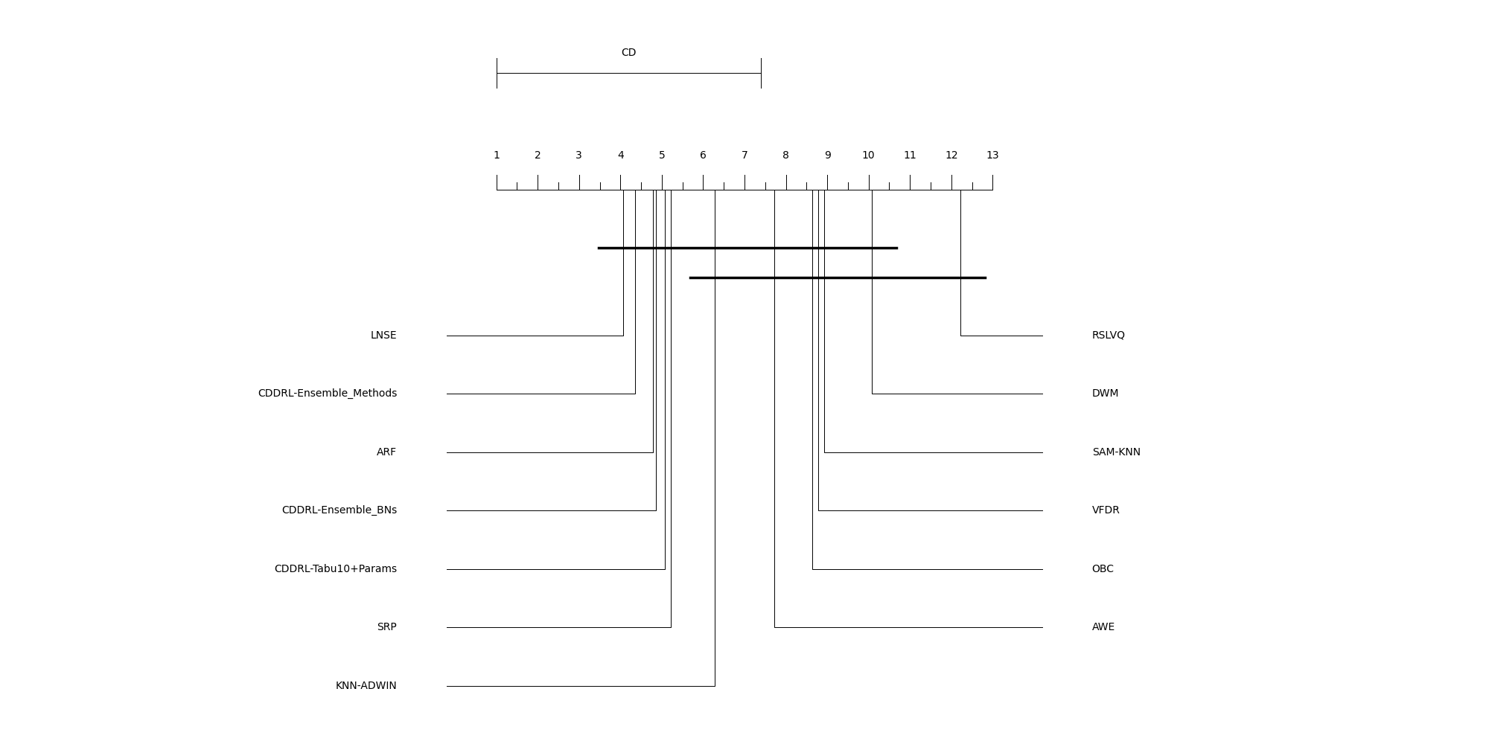
Friedman Test – F1, No Usenet and NN-UN
Algorithm | Rank
LNSE | 4.071
CDDRL-Ensemble_Methods | 4.357
ARF | 4.786
CDDRL-Ensemble_BNs | 4.857
CDDRL-Tabu10+Params | 5.071
SRP | 5.214
KNN-ADWIN | 6.286
AWE | 7.714
OBC | 8.643
VFDR | 8.786
SAM-KNN | 8.929
DWM | 10.071
RSLVQ | 12.214
CD | 6.405

Slide 21
Friedman Test – Ranking Summary
Algorithm | No_Usenet_and_Stress | No_Usenet_and_Instagram | No_Usenet | Stress_Only | F1_No_Usenet | With_AUC_No_Usenet | With_AUC_No_Usenet_and_Instagram | All_Datasets
CDDRL-Tabu10+Params | 6.54 | 5.22 | 5.45 | 4.45 | 5.07 | 4.51 | 4.31 | 4.48
CDDRL-Ensemble_BNs | 4.65 | 4.09 | 4.88 | 5.2 | 4.86 | 4.3 | 3.73 | -
CDDRL-Ensemble_Methods | 5.58 | 4.92 | 4.89 | 4.4 | 4.36 | 4.2 | 4.28 | -
LNSE | 4.17 | 5.07 | 4.69 | 5.43 | 4.07 | 3.88 | 4.13 | 4.25
ARF | 3.35 | 5.11 | 4.86 | 6.75 | 4.79 | 4.01 | 4.23 | 4.32
SRP | 5.35 | 5.27 | 4.99 | 4.68 | 5.21 | 4.32 | 4.64 | 4.17
KNN-ADWIN | 7.71 | 6.72 | 7.06 | 6.65 | 6.29 | 6.13 | 5.92 | 5.93
OBC | 8.94 | 8.26 | 8.63 | 8.65 | 8.64 | 7.15 | 6.91 | 6.91
VFDR | 9.77 | 8.96 | 8.47 | 7.6 | 8.79 | 6.5 | 6.85 | 6.53
AWE | 7.31 | 8.18 | 7.28 | 7.85 | 7.71 | - | - | 5.41
DWM | 10.33 | 8.74 | 9.09 | 8.23 | 10.07 | - | - | 6.87
SAM-KNN | 8 | 8.3 | 8.41 | 9.35 | 8.93 | - | - | 6.79
RSLVQ | 13.73 | 12.18 | 12.31 | 11.78 | 12.21 | - | - | 10.32
NN-UN | 9.56 | - | - | - | - | - | - | -

Slide 22
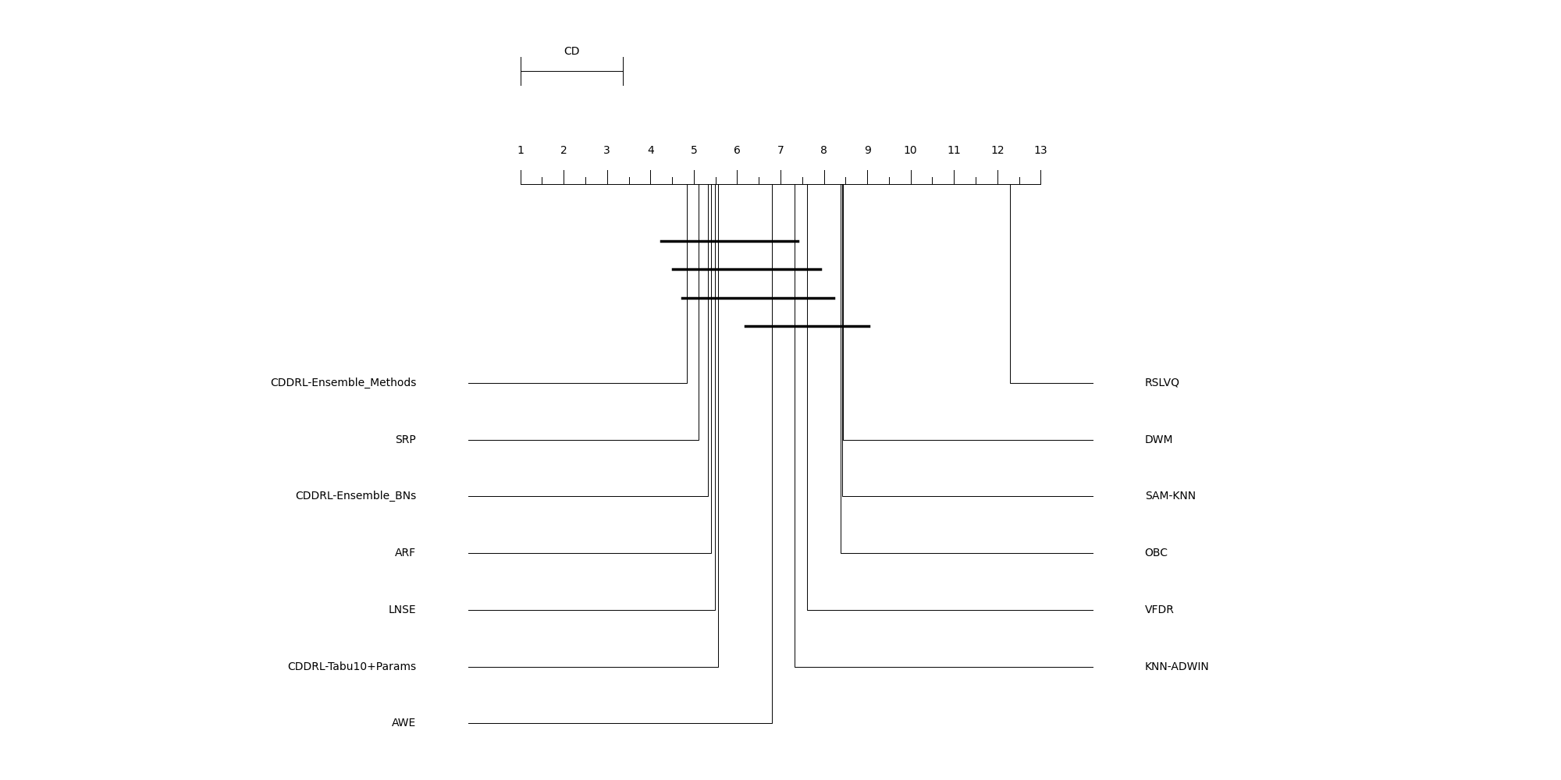
Friedman Test – Without NN-UN
Algorithm | Rank
CDDRL-Ensemble_Methods | 4.843
SRP | 5.118
CDDRL-Ensemble_BNs | 5.333
ARF | 5.392
LNSE | 5.480
CDDRL-Tabu10+Params | 5.569
AWE | 6.794
KNN-ADWIN | 7.324
VFDR | 7.618
OBC | 8.382
SAM-KNN | 8.422
DWM | 8.441
RSLVQ | 12.284
CD | 2.373

Slide 23
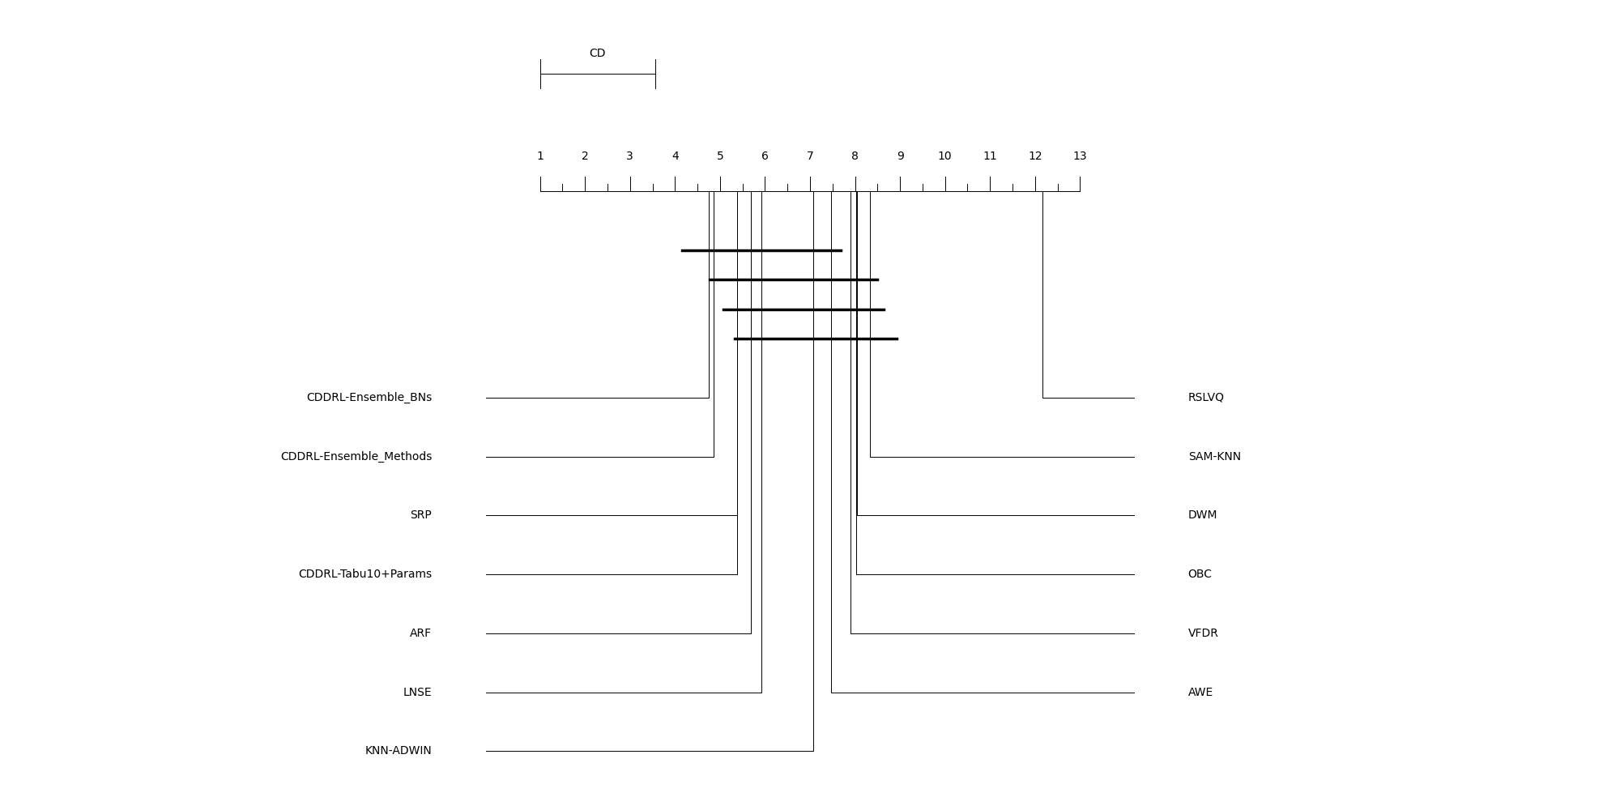
Friedman Test – No Instagram and NN-UN
Algorithm | Rank
CDDRL-Ensemble_BNs | 4.750
CDDRL-Ensemble_Methods | 4.864
SRP | 5.375
CDDRL-Tabu10+Params | 5.386
ARF | 5.682
LNSE | 5.920
KNN-ADWIN | 7.079
AWE | 7.466
VFDR | 7.898
OBC | 8.034
DWM | 8.045
SAM-KNN | 8.330
RSLVQ | 12.170
CD | 2.555

Slide 24
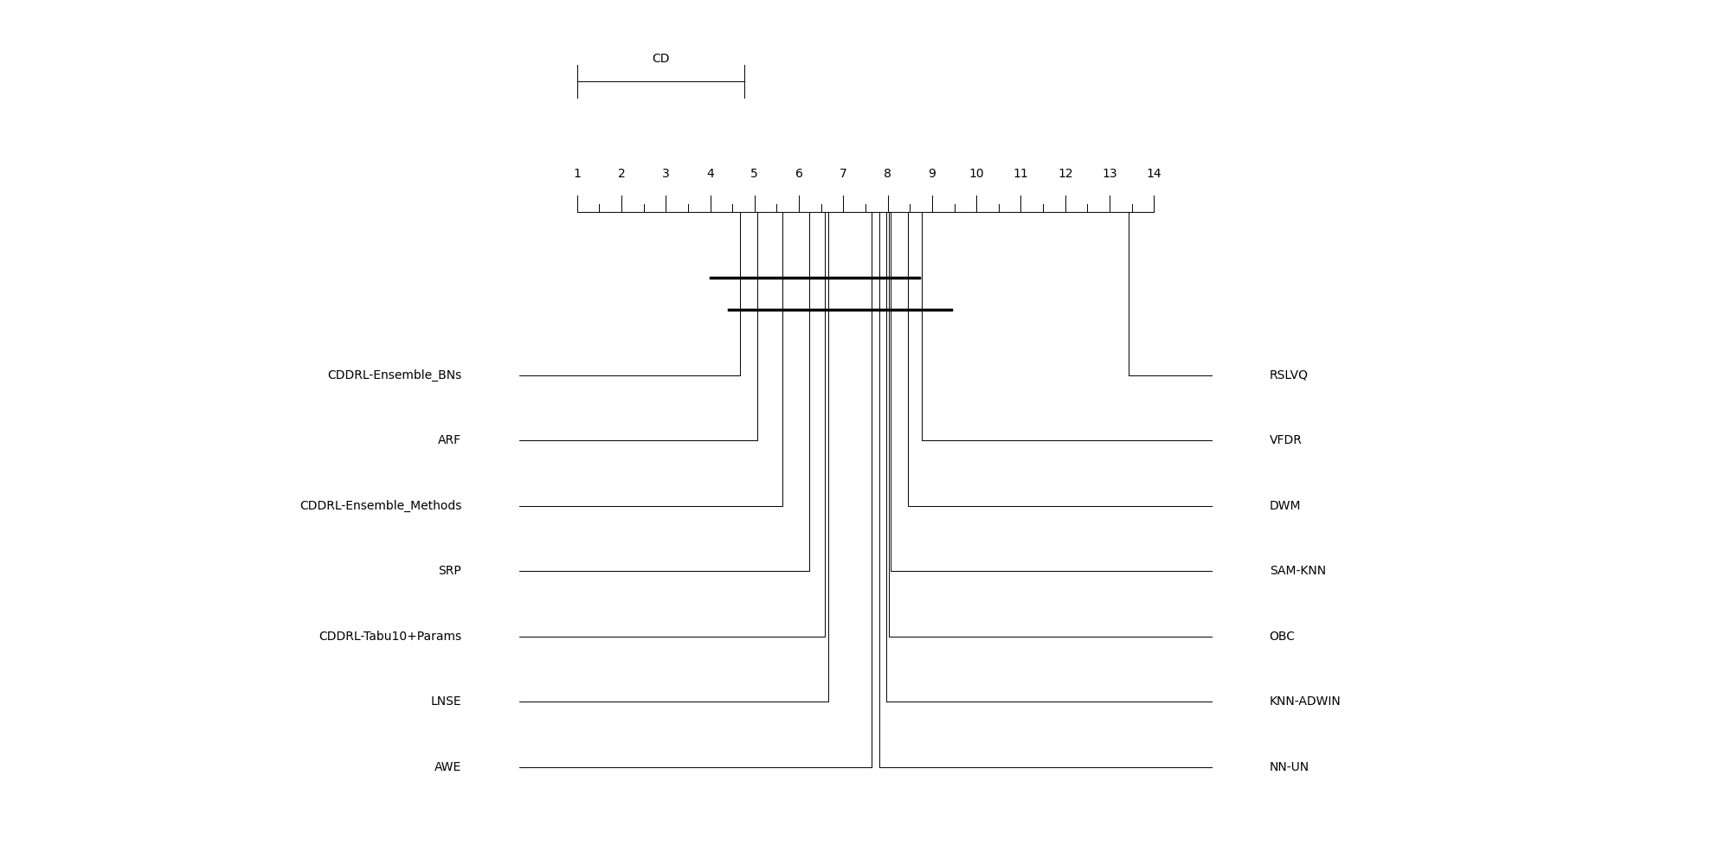
Friedman Test – All Algos, Without Stress and Instagram
Algorithm | Rank
CDDRL-Ensemble_BNs | 4.667
ARF | 5.063
CDDRL-Ensemble_Methods | 5.625
SRP | 6.229
CDDRL-Tabu10+Params | 6.583
LNSE | 6.667
AWE | 7.646
NN-UN | 7.813
KNN-ADWIN | 7.958
OBC | 8.021
SAM-KNN | 8.063
DWM | 8.458
VFDR | 8.771
RSLVQ | 13.438
CD | 3.767

Slide 25
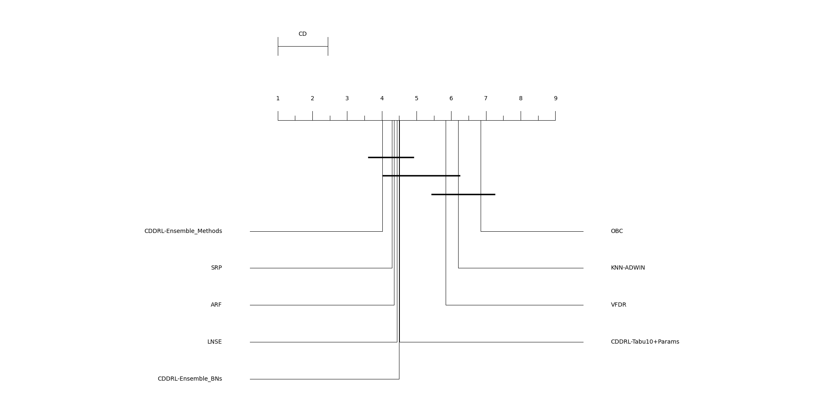
Friedman Test – Without no AUC Algos
Algorithm | Rank
CDDRL-Ensemble_Methods | 4.017
SRP | 4.297
ARF | 4.347
LNSE | 4.441
CDDRL-Ensemble_BNs | 4.500
CDDRL-Tabu10+Params | 4.508
VFDR | 5.839
KNN-ADWIN | 6.203
OBC | 6.847
CD | 1.439

Slide 26
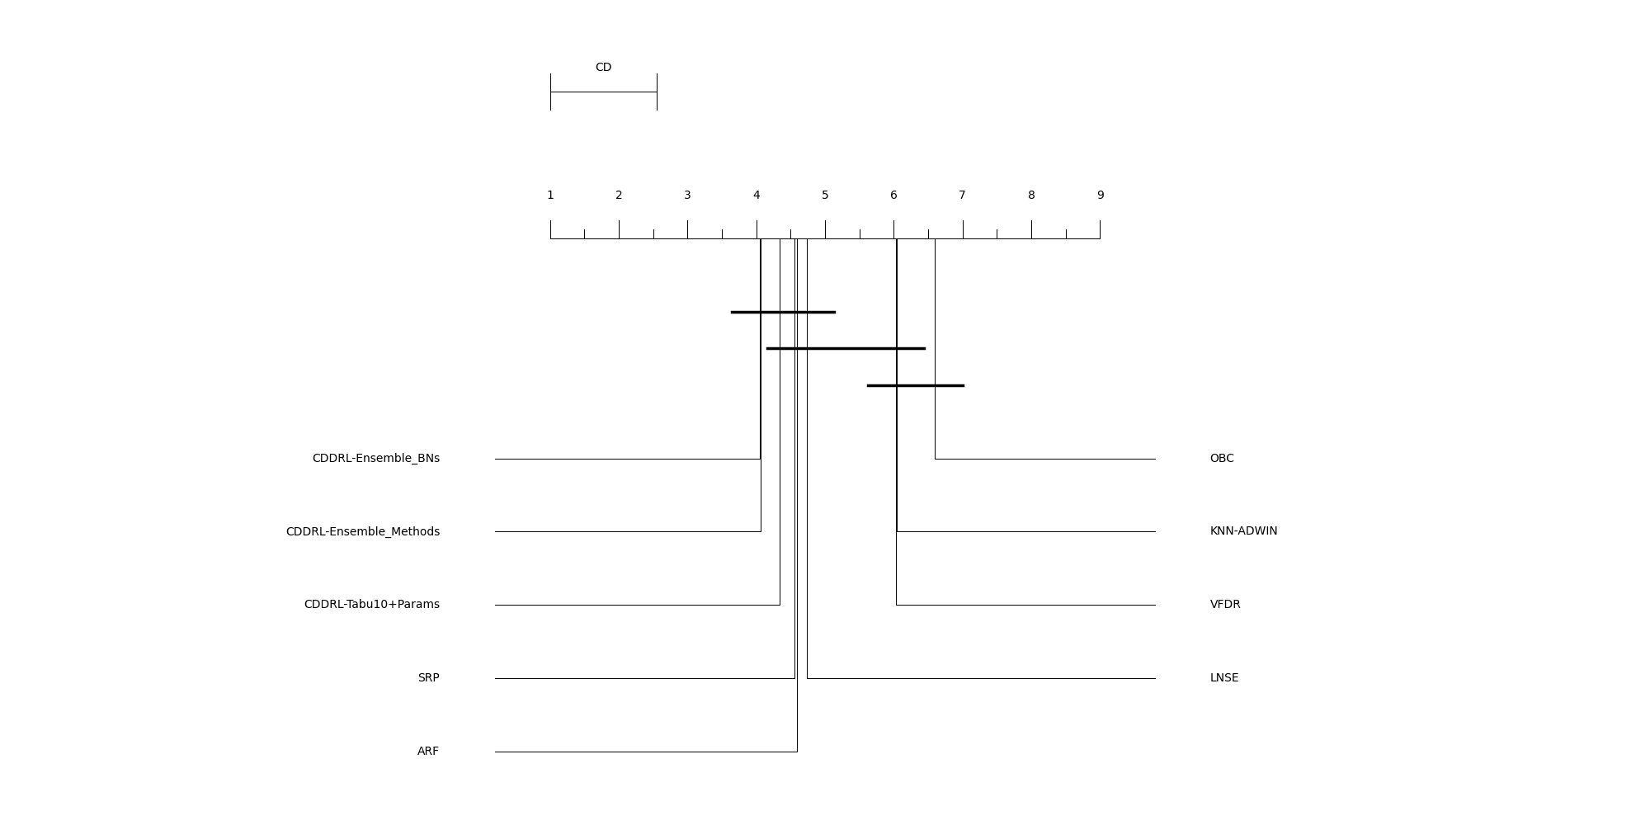
Friedman Test – Without no AUC Algos, No Instagram
Algorithm | Rank
CDDRL-Ensemble_BNs | 4.049
CDDRL-Ensemble_Methods | 4.059
CDDRL-Tabu10+Params | 4.343
SRP | 4.559
ARF | 4.588
LNSE | 4.735
VFDR | 6.029
KNN-ADWIN | 6.039
OBC | 6.598
CD | 1.548

Slide 27
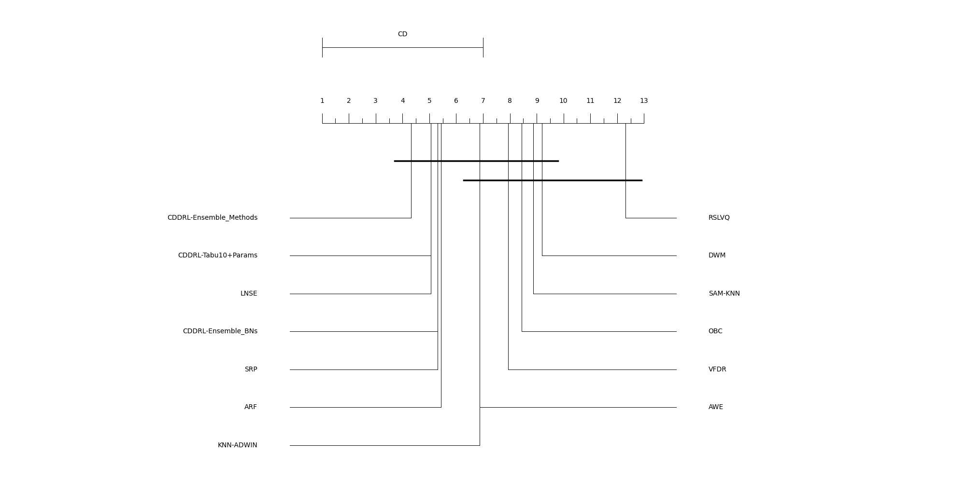
Friedman Test – F1, No NN-UN
Algorithm | Rank
CDDRL-Ensemble_Methods | 4.313
CDDRL-Tabu10+Params | 5.063
LNSE | 5.063
CDDRL-Ensemble_BNs | 5.313
SRP | 5.313
ARF | 5.438
KNN-ADWIN | 6.875
AWE | 6.875
VFDR | 7.938
OBC | 8.438
SAM-KNN | 8.875
DWM | 9.188
RSLVQ | 12.313
CD | 5.991

Slide 28
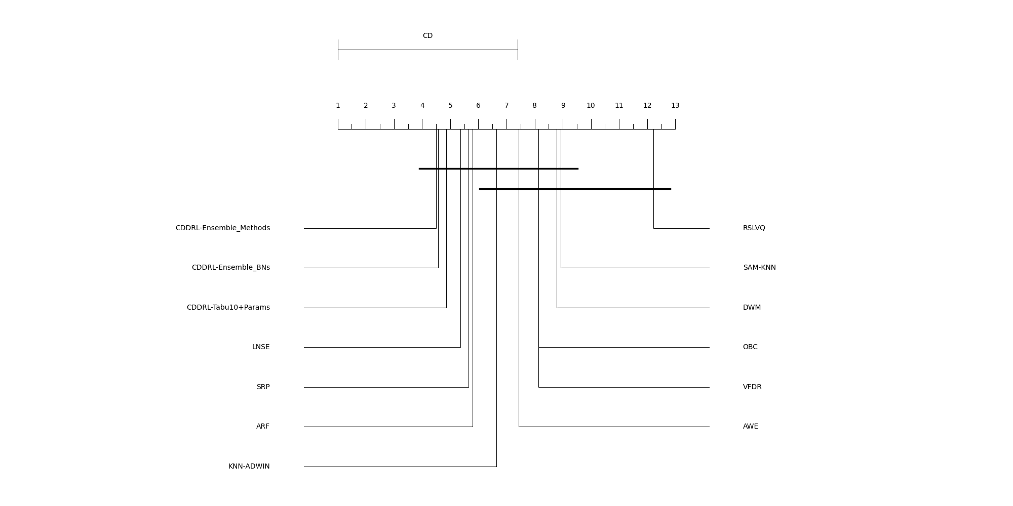
Friedman Test – F1, No Instagram and NN-UN
Algorithm | Rank
CDDRL-Ensemble_Methods | 4.500
CDDRL-Ensemble_BNs | 4.571
CDDRL-Tabu10+Params | 4.857
LNSE | 5.357
SRP | 5.643
ARF | 5.786
KNN-ADWIN | 6.643
AWE | 7.429
VFDR | 8.143
OBC | 8.143
DWM | 8.786
SAM-KNN | 8.929
RSLVQ | 12.214
CD | 6.405

